Slide 1
Module – 5
Chapter – 13
Clustering Algorithms

Slide 2
13.1 INTRODUCTION TO CLUSTERING APPROACHES
Cluster analysis is the fundamental task of unsupervised learning.
Unsupervised learning involves exploring the given dataset.
Cluster analysis is a technique of partitioning a collection of unlabelled objects that have many attributes into meaningful disjoint groups or clusters.
This is done using a trial and error approach as there are no supervisors available as in classification.
The characteristic of clustering is that the objects in the clusters or groups are similar to each other within the clusters while differ from the objects in other clusters significantly.

Slide 3
The input for cluster analysis is examples or samples.
These are known as objects, data points or data instances.
All the samples or objects with no labels associated with them are called unlabelled.
The output is the set of clusters (or groups) of similar data if it exists in the input.

Slide 4
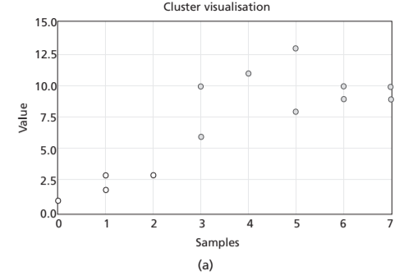
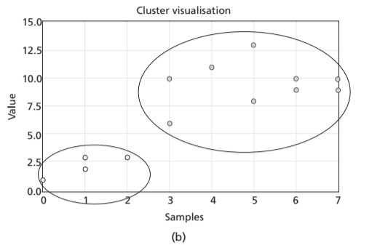
For example,
The following Figure 13.1(a) shows data points or samples with two features shown in different shaded samples and Figure 13.1(b) shows the manually drawn ellipse to indicate the clusters formed.

Slide 5
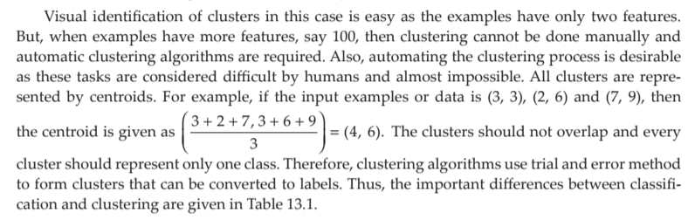

Slide 6
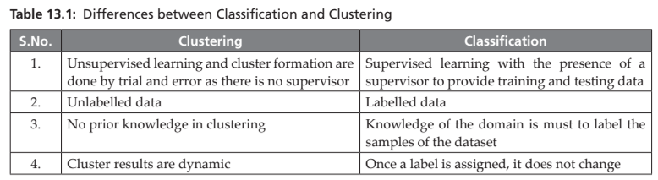

Slide 7
Applications of Clustering
1. Grouping based on customer buying patterns
2. Profiling of customers based on lifestyle
3. In information retrieval applications (like retrieval of a document from a collection of documents)
4. Identifying the groups of genes that influence a disease
5. Identification of organs that are similar in physiology functions
6. Taxonomy of animals, plants in Biology
7. Clustering based on purchasing behaviour and demography
8. Document indexing
9. Data compression by grouping similar objects and finding duplicate objects

Slide 8
Challenges of Clustering Algorithms
A huge collection of data with higher dimensions (i.e., features or attributes) can pose a problem for clustering algorithms.
With the arrival of the internet, billions of data are available for clustering algorithms.
This is a difficult task, as scaling is always an issue with clustering algorithms.
Scaling is an issue where some algorithms work with lower dimension data but do not perform well for higher dimension data.
Also, units of data can post a problem, like some weights in kg and some in pounds can pose a problem in clustering.
Designing a proximity measure is also a big challenge.

Slide 9
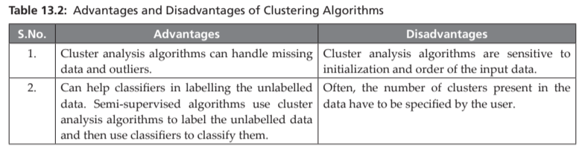
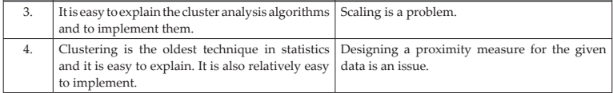

Slide 10
13.2 PROXIMITY MEASURES
Clustering algorithms need a measure to find the similarity or dissimilarity among the objects to group them.
Similarity and dissimilarity are collectively known as proximity measures. Often, the distance measures are used to find similarity between two objects, say i and j.
Distance measures are known as dissimilarity measures, as these indicate how one object is different from another.

Slide 11
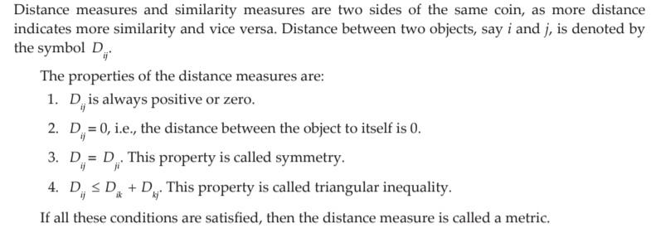

Slide 12
Based on the data types of the attributes of an object, distance measures vary.
It can be recollected that the data types are divided into categorical and quantitative variables.
Quantitative variables are numbers and are of two types – nominal and ordinal.
For example, gender is a nominal variable as gender can be enumerated as Gender = {male, female}.
Ordinal variables look like nominal variables but have an inherent order present in the enumeration.
For example, temperature is a nominal variable as temperature can be enumerated as Temperature = {low, medium, high}.
One can observe the inherent order present, that is, medium > low and low < medium.
Quantitative variables are real or Integer numbers or binary data. In binary data, the attributes of the object can take a Boolean value. Objects whose attributes take binary data are called binary objects.

Slide 13
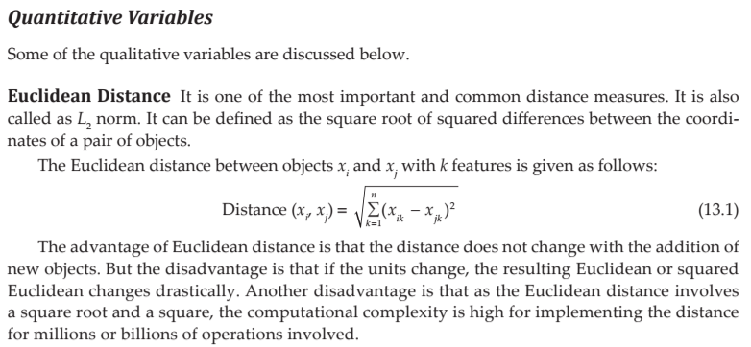
Let us review some of the proximity measures.

Slide 14
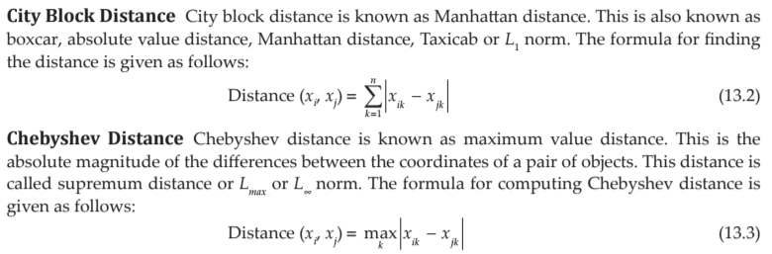
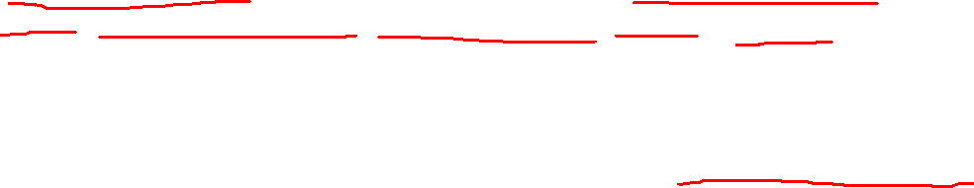

Slide 15
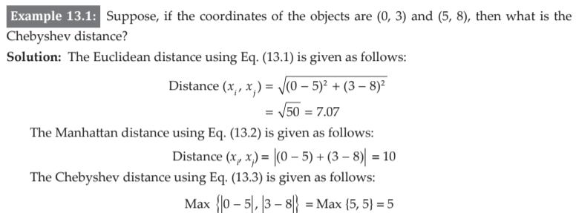


Slide 16

This is called Minkowski distance. Here, r is a parameter.
When the value of r is 1, the distance measure is called city block distance.
When the value of r is 2, the distance measure is called Euclidean distance.
When, r is ∞, then this is Chebyshev distance.

Slide 17
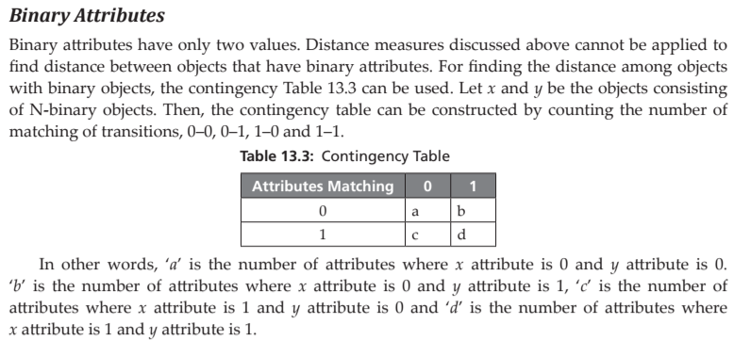

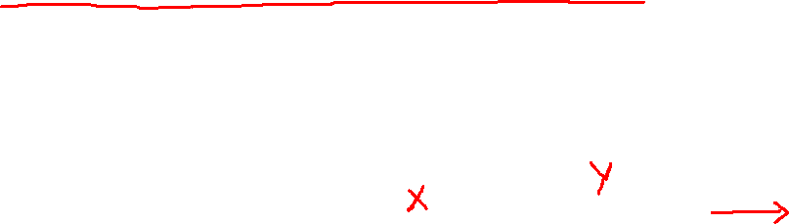
No. of attributes

Slide 18
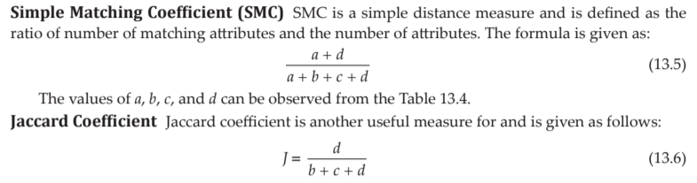

Slide 19
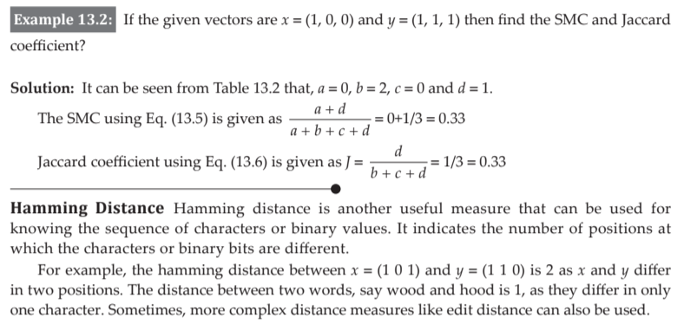
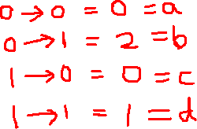

Slide 20
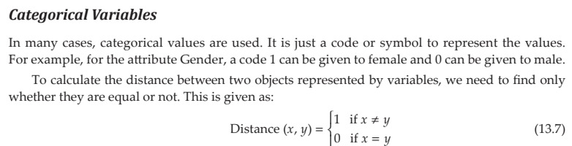

Slide 21
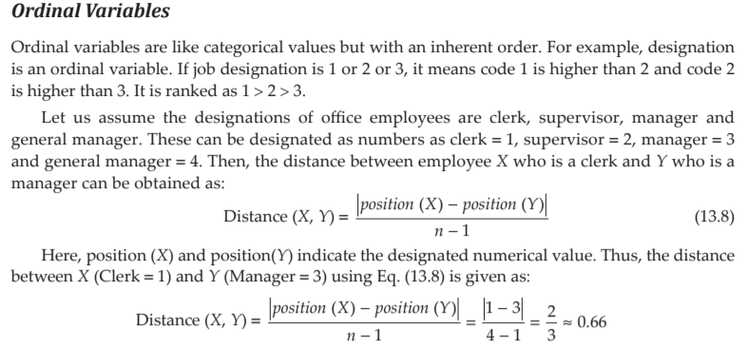
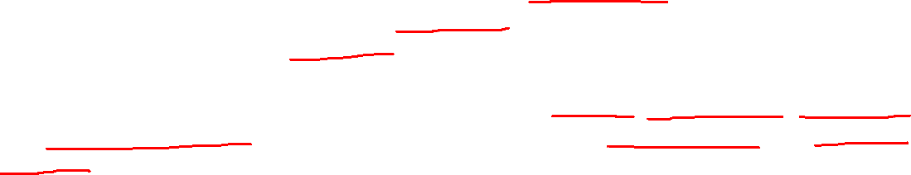

Slide 22
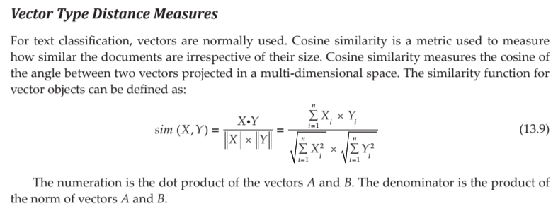
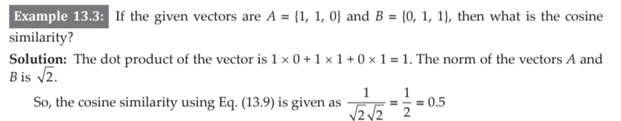

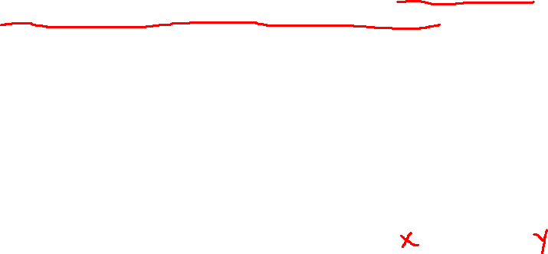

Slide 23
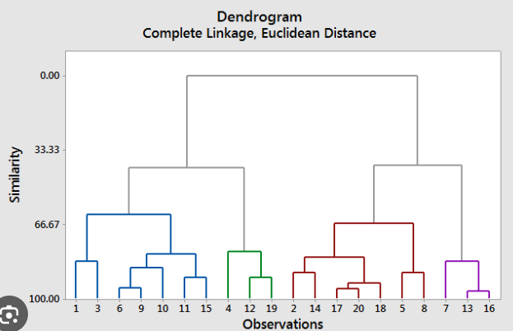
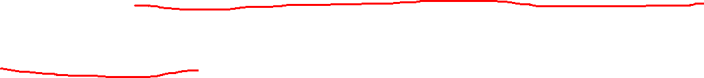
13.3 HIERARCHICAL CLUSTERING ALGORITHMS
Hierarchical methods produce a nested partition of objects with hierarchical relationships among objects. Often, the hierarchy relationship is shown in the form of a dendrogram.
Hierarchical methods include categories, agglomerative methods and divisive methods.
In agglomerative methods, initially all individual samples are considered as a cluster, that is, a cluster with a single element
Then, they are merged and the process is continued to get a single cluster.

Slide 24
Divisive methods use another kind of philosophy, where a single cluster of all samples of the dataset taken initially is chosen and then partitioned.
This partition process is continued until the cluster is split into smaller clusters.
Agglomerative methods merge clusters to reduce the number of clusters.
This is repeated each time while merging two closest clusters to get a single cluster.

Slide 25
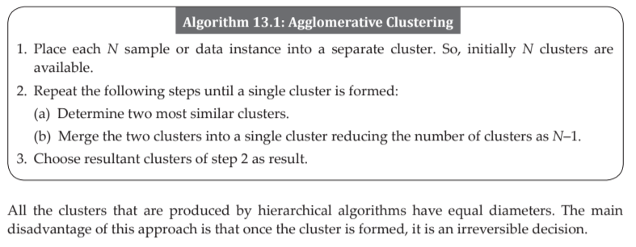
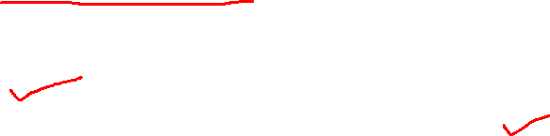

Slide 26
13.3.1 Single Linkage or MIN Algorithm
Hierarchical clustering algorithms produce nested clusters, which can be visualized as a hierarchical tree or dendrogram.
The idea behind this approach is proximity among clusters.
In single linkage algorithm, the smallest distance (x, y), where x is from one cluster and y is from another cluster, is the distance between all possible pairs of the two groups or clusters (or simply the smallest distance of two points where points are in different clusters) and is used for merging the clusters.
In single-link (or single linkage) hierarchical clustering, we merge in each step the two clusters whose two closest members have the smallest distance

Slide 27
This corresponds to finding of minimum spanning tree (MST) of a graph.
The distance measures between individual samples or data points is already demonstrated in the previous section 13.2.
To understand the single linkage algorithm, go through the following numerical problem that involves finding the distance between clusters.

Slide 28
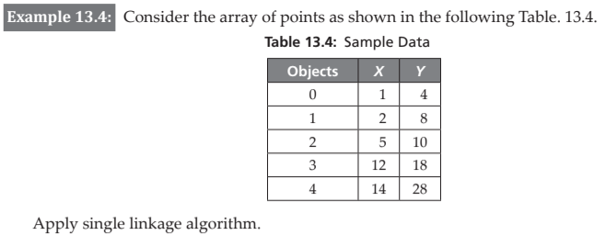

Slide 29
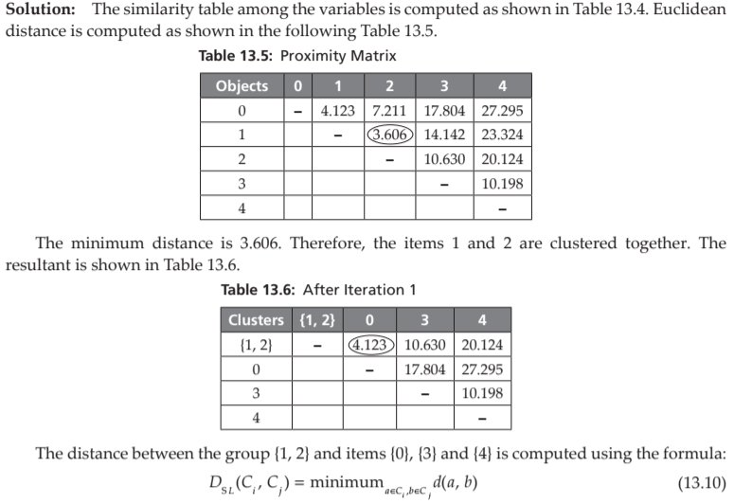

Slide 30
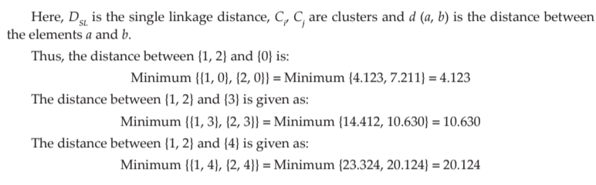

Slide 31
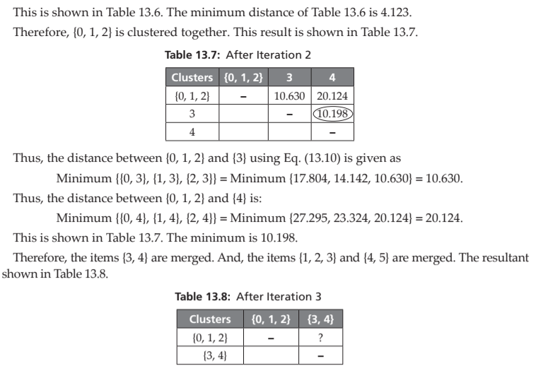

Slide 32
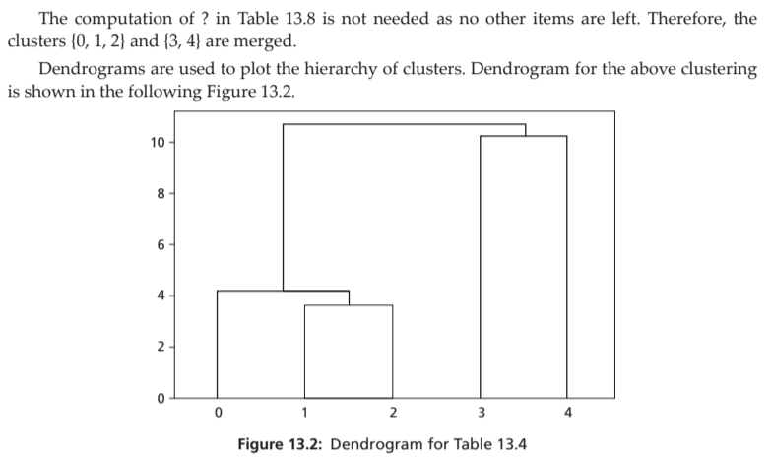

Slide 33
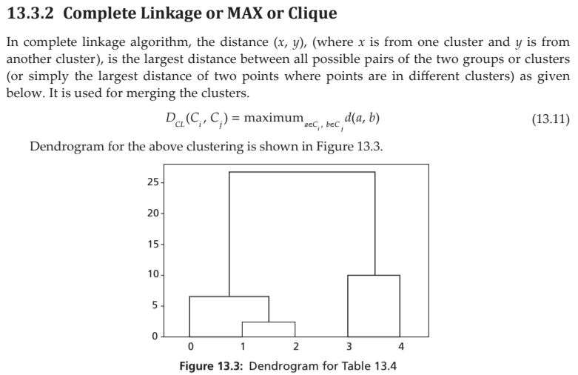

Slide 34
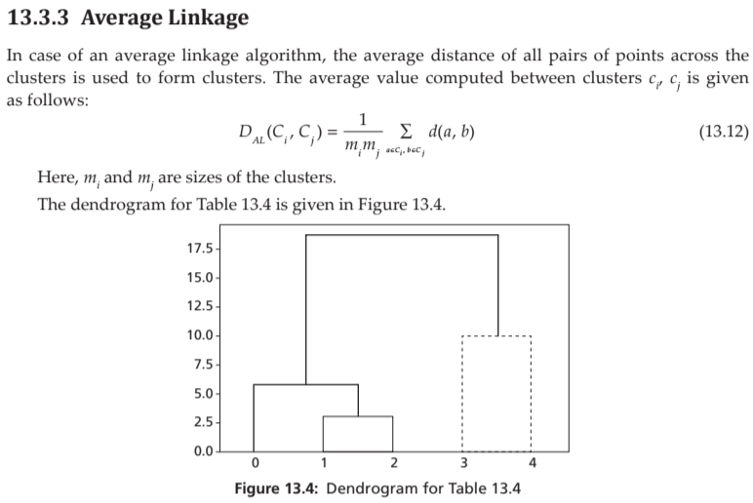

Slide 35
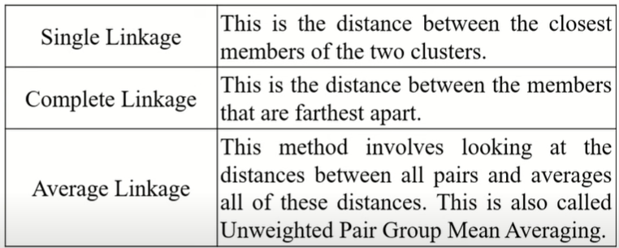

Slide 36
13.3.4 Mean-Shift Clustering Algorithm
Mean-shift is a non-parametric and hierarchical clustering algorithm. This algorithm is also known as mode seeking algorithm or a sliding window algorithm.
It has many applications in image processing and computer vision.
There is no need for any prior knowledge of clusters or shape of the clusters present in the dataset.
The algorithm slowly moves from its initial position towards the dense regions.
The algorithm uses a window, which is basically a weighting function.
Mean-shift algorithm basically assigns the datapoints to the clusters iteratively by shifting points towards the highest density of datapoints i.e. cluster centroid.

Slide 37
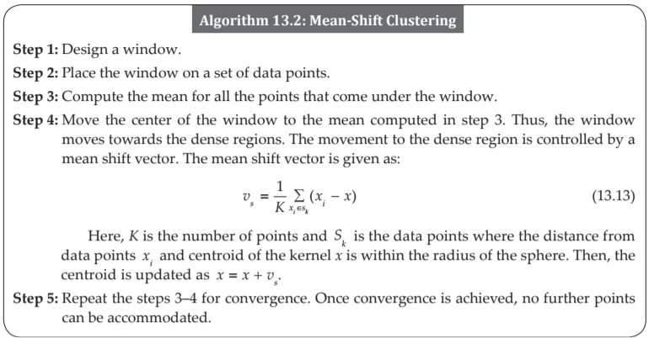
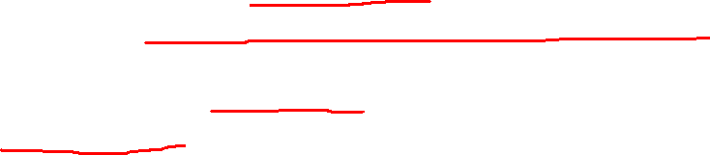

Slide 38
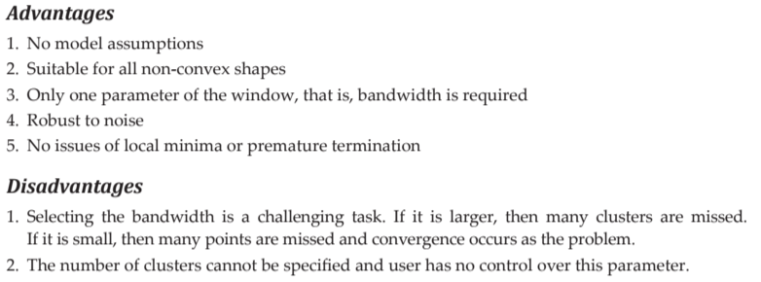

Slide 39
13.4 PARTITIONAL CLUSTERING ALGORITHM
‘k-means’ algorithm is a straightforward iterative partitional algorithm.
Here, k stands for the user specified requested clusters as users are not aware of the clusters that are present in the dataset.
The k-means algorithm assumes that the clusters do not overlap. Therefore, a sample or data point can belong to only one cluster in the end.
Also, this algorithm can detect clusters of shapes like circular or spherical.

Slide 40
Initially, the algorithm needs to be initialized.
The algorithm can select k data points randomly or use the prior knowledge of the data.
In most cases, in k-means algorithm setup, prior knowledge is absent.
The composition of the cluster is based on the initial condition, therefore, initialization is an important task.
The sample or data points need to be normalized for better performance.
The core process of the k-mean algorithm is assigning a sample to a cluster, that is, assigning each sample or data point to the k cluster centers based on its distance and the centroid of the clusters.

Slide 41
This distance should be minimum. As a new sample is added, new computation of mean vectors of the points for that cluster to which sample is assigned is required.
Therefore, this iterative process is continued until no change of instances to clusters is noticed.
This algorithm then terminates and the termination is guaranteed.

Slide 42
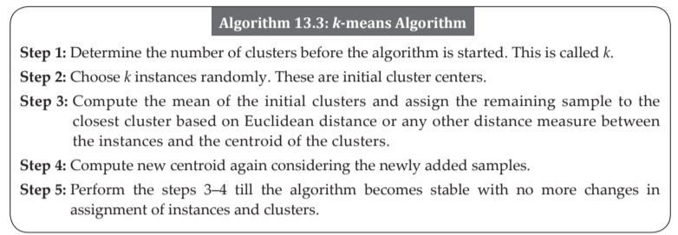

Slide 43
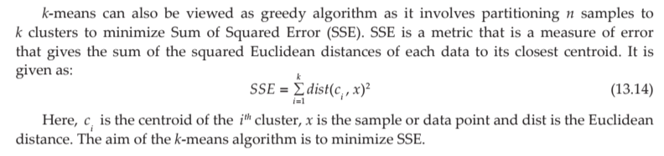
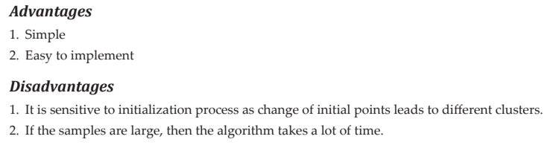

Slide 44
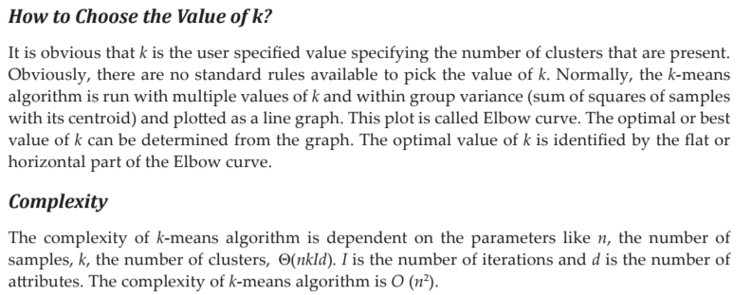

Slide 45
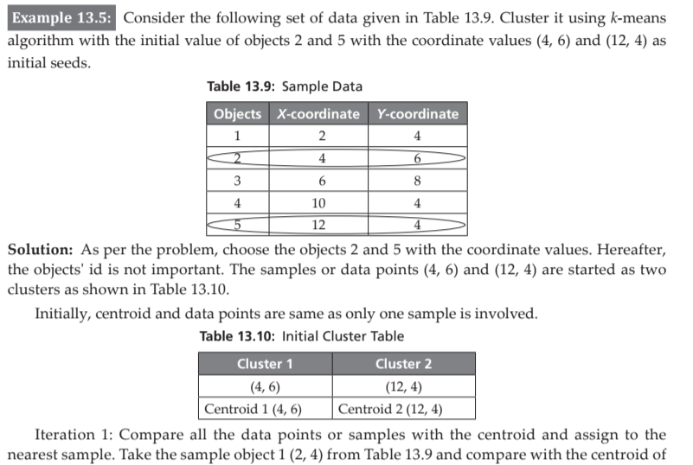
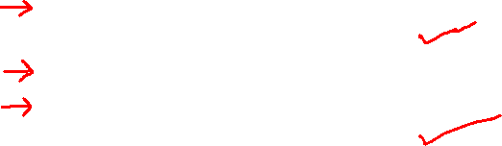

Slide 46
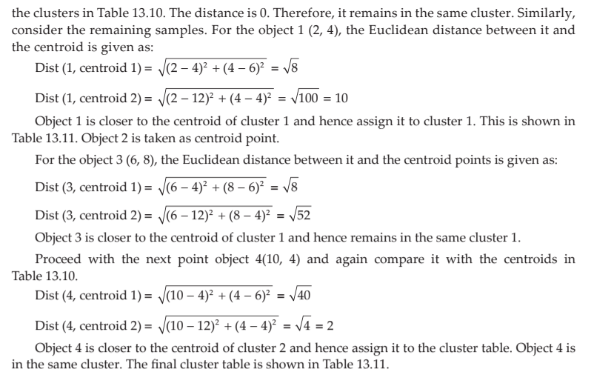
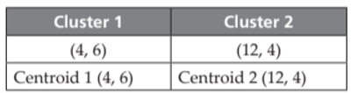


Slide 47
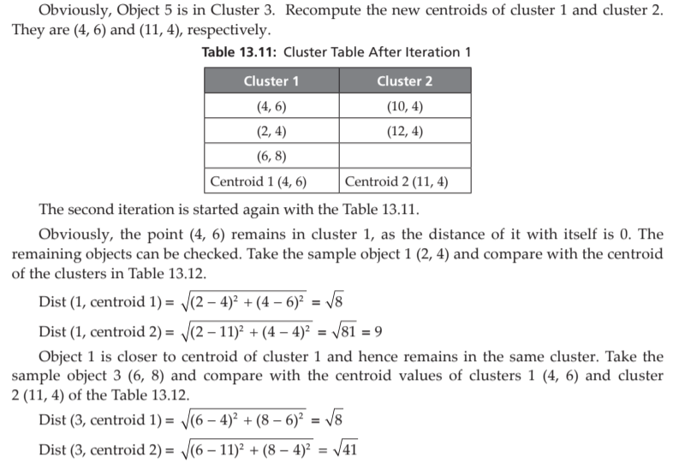
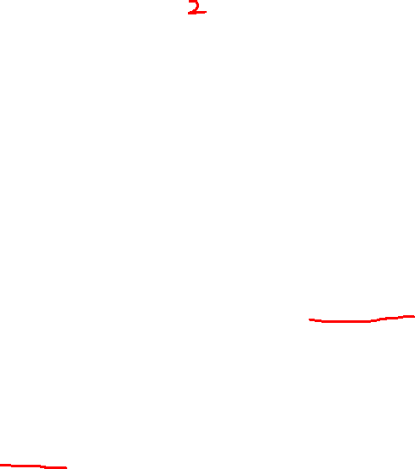

Slide 48
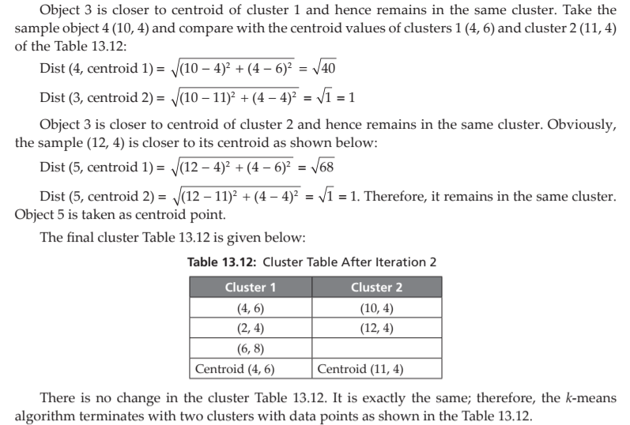

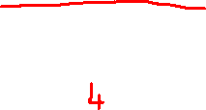

Slide 49
13.5 DENSITY-BASED METHODS
Density-based spatial clustering of applications with noise (DBSCAN) is one of the density-based algorithms.
Density of a region represents the region where many points above the specified threshold are present.
In a density-based approach, the clusters are regarded as dense regions of objects that are separated by regions of low density such as noise. This is same as a human’s intuitive way of observing clusters.
The concept of density and connectivity is based on the local distance of neighbours.

Slide 50
The functioning of this algorithm is based on two parameters, the size of the neighbourhood (e) and the minimum number of points (m).
1. Core point – A point is called a core point if it has more than specified number of points (m) within e-neighbourhood.
2. Border point – A point is called a border point if it has fewer than ‘m’ points but is a neighbour of a core point.
3. Noise point – A point that is neither a core point nor border point.

Slide 51
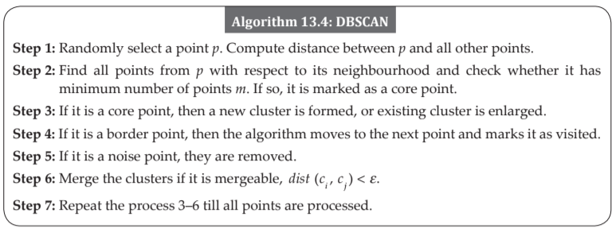

Slide 52


Slide 53


Slide 54


Slide 55
Monotonicity Property
CLIQUE uses anti-monotonicity property or apriori property of the famous apriori algorithm.
It means that all the subsets of a frequent item should be frequent. Similarly, if the subset is infrequent, then all its supersets are infrequent as well.
Based on the apriori property, one can conclude that a k-dimensional cell has r points if and only if every (k – 1) dimensional projections of this cell have atleast r points.
So like association rule mining that uses apriori rule, the candidate dense cells are generated for higher dimensions. The algorithm works in two stages as shown below.

Slide 56



Slide 57
Advantages of CLIQUE
1. Insensitive to input order of objects
2. No assumptions of underlying data distributions
3. Finds subspace of higher dimensions such that high-density clusters exist in those subspaces
Disadvantage
The disadvantage of CLIQUE is that tuning of grid parameters, such as grid size, and finding optimal threshold for finding whether the cell is dense or not is a challenge.

